Slide 1
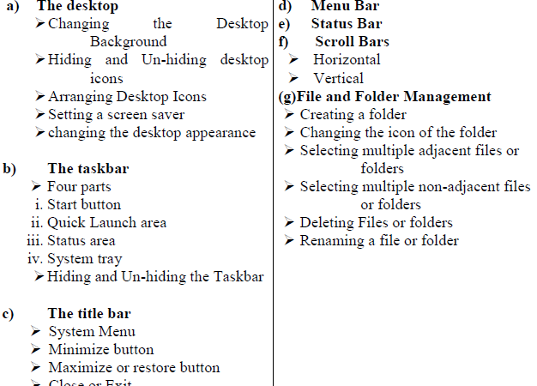
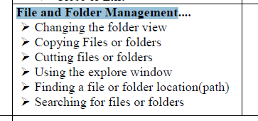
Lect IV: Working with Windows

Slide 2
Introduction to Windows
The Windows environment is the onscreen work area provided by Windows, analogous to a physical desktop, and the operating system's core extension points.
Topic | Description
Desktop | The desktop is the user's work area for their programs. It's not a way to promote awareness of your program or its brand. Don't abuse it!
Taskbar | The taskbar is the access point for programs displayed on the desktop. With the new Windows 7 taskbar features, users can give commands, access resources, and view program status directly from the taskbar.
Notification Area | The notification area provides notifications and status. Well-designed programs use the notification area appropriately, without being annoying or distracting.

Slide 3
Topic | Description
Control Panels | Use control panel items to help users configure system-level features and perform related tasks. Programs that have a user interface should be configured directly from their UI instead
Help | Use Help as a secondary mechanism to help users complete and better understand tasks the primary mechanism being the UI itself. Apply these guidelines to make the content truly helpful and easy to find.
User Account Control | A well designed User Account Control experience helps prevent unwanted system-wide changes in a way that is predictable and requires minimal effort.

Slide 4
Microsoft Windows
Microsoft windows is a series of graphical interface operating systems developed, market and sold by Microsoft.
Microsoft introduced an operating Environment/System named “Windows” on November 20th, 1985 as a graphical operating system shell for MS DOS in response to the growing interest in Graphical User Interface (GUI).

Slide 5
List of Windows
MS-DOS - Microsoft Disk Operating System (1981)
Windows 1.0 – 2.0 (1985-1992)
Windows 3.0 – 3.1 (1990–1994)
Windows 95 (August 1995)
Windows 98 (June 1998)
Windows ME - Millennium Edition (September 2000)
Windows NT 31. - 4.0 (1993-1996)
Windows 2000 (February 2000)
Windows XP (October 2001)
Windows Vista (November 2006)
Windows 7 (October, 2009)
Windows 8 (August 1, 2012)
Windows 10 ( July 29, 2015)

Slide 6
GUI = Graphical User Interface
A graphical user interface (GUI) is an interface through which a user interacts with electronic devices such as computers, hand-held devices and other appliances.
This interface uses icons, menus and other visual indicator (graphics) representations to display information and related user controls, unlike text-based interfaces, where data and commands are in text.
GUI representations are manipulated by a pointing device such as a mouse, trackball, stylus, or a finger on a touch screen
GUI Displays:
  Graphics (blue background)
  Text

Slide 7
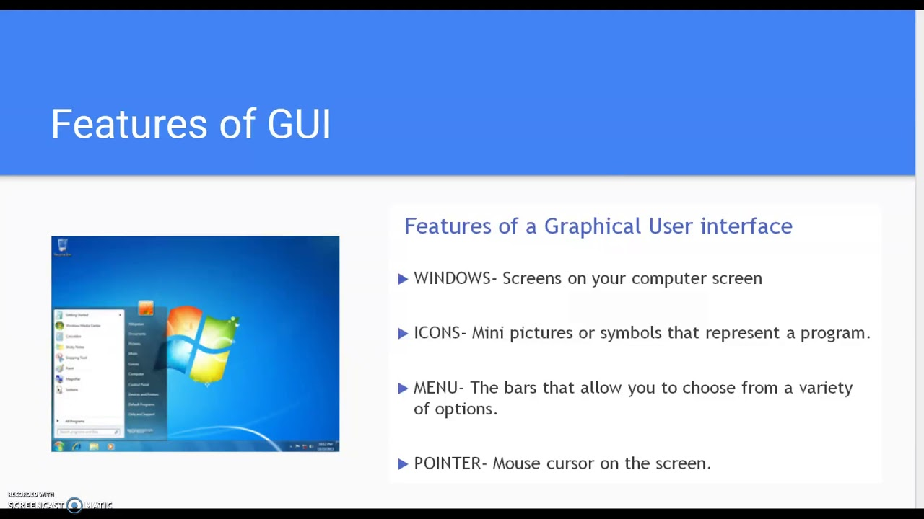

Slide 8
Desktop
When referring to an operating system or GUI (graphical user interface), the desktop is a system of organization of icons on a screen.
The Microsoft Windows desktop was first introduced with Microsoft Windows 95 and included with every version of Windows since then.
The image on next slide is an example of the Microsoft Windows 10 desktop.

Slide 9
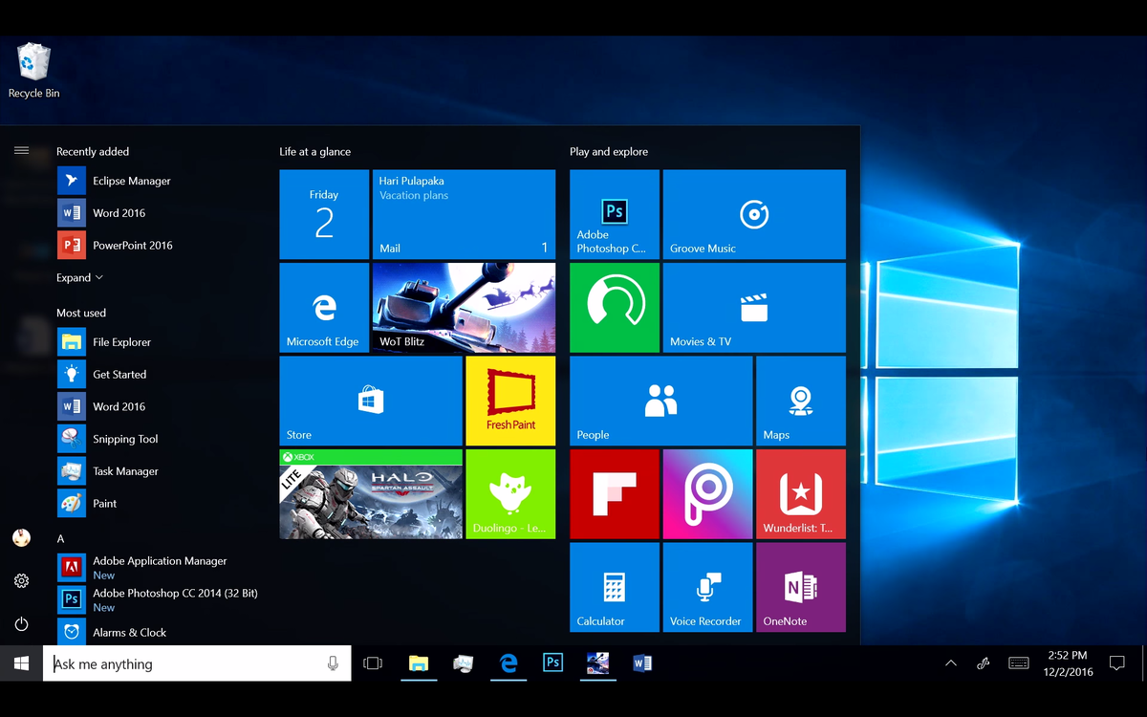
Icon
Wall paper
Menu
Tray Status Area
Start Button
Search box
Taskbar Icons
Windows Notification area

Slide 10
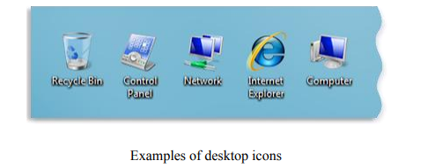
Icons
Icons are small pictures that represent files, folders, programs, and other items.
When you first start Windows, you'll see at least one icon on your desktop: the Recycle Bin (more on that later).
Your computer manufacturer might have added other icons to the desktop.
Double-clicking a desktop icon starts or opens the item it represents. For example, double-clicking the Internet Explorer icon starts Internet Explorer.

Slide 11
Working with desktop icons
Adding and removing icons from the desktop
  You can choose which icons appear on the desktop—you can add or remove an icon at any time.
  Some people like a clean, uncluttered desktop with few or no icons.
  Others place dozens of icons on their desktop to give them quick access to frequently used programs, files, and folders.
  If you want easy access from the desktop to your favorite files or programs, create shortcuts to them.
  A shortcut is an icon that represents a link to an item, rather than the item itself. When you double-click a shortcut, the item opens.
  If you delete a shortcut, only the shortcut is removed, not the original item. You can identify shortcuts by the arrow on their icon.

Slide 12
Desktop Wallpaper
A wallpaper or background (also known as a desktop wallpaper, desktop background, desktop picture or desktop image on computers) is a digital image (photo, drawing etc.) used as a decorative background of a graphical user interface on the screen of a computer, smartphone or other electronic devices.

Slide 13
Search box
Windows 10
On the Windows desktop, locate the taskbar, usually found at the bottom of the screen. In the Windows search box, located next to the Start, type in the name of the program or file you want to access.
In the search results, select the file or program that matches what you want to open.
Windows search box tips
The search box in Windows 10 allows you to execute searches on the Internet, in addition to searching in Windows.
After typing in your search text, pressing Enter immediately opens the highlighted file or program in the search results.
For example, you could type calculator and the first highlighted program should be the Windows Calculator.
Press Enter to open the Calculator without having to move your hands from the keyboard. As you are typing, you can also use the down arrow to move to the program or file you want to open.

Slide 14
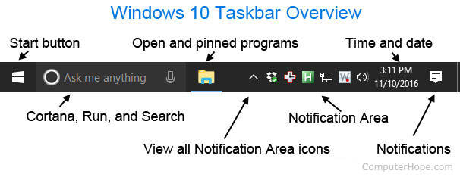
Taskbar
The taskbar is an element of an operating system located at the bottom of the screen. It allows you to locate and launch programs through Start and the Start menu, or view any program that is currently open.
The taskbar first introduced with Microsoft Windows 95 and can be found in all subsequent versions of Windows
4 Parts of the:
Start Button
Quick launch
Taskbar button area
Tray

Slide 15
Start Button/Menu
The Start menu is a graphical user interface element used in Microsoft Windows since Windows 95 and in some other operating systems. It provides a central launching point for computer programs and performing other tasks.
Main Features:
Programs
Settings
Documents
Shut Down Computer

Slide 16
Quick Launch Toolbar
Quick Launch is a section of the Microsoft taskbar that enables a user the ability to launch their programs.
It is located to the right of Start and to the left of any open programs.
You only have to click once to open the program. Any program can be added or pinned into quick launch by clicking the right button and selecting “Pin this program to taskbar”.
Examples:
Internet Explorer
Outlook Express

Slide 17

Tray Status Area
Contains clock, speaker volume, controls operation of system (automatically started).

Slide 18
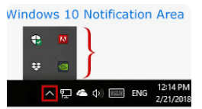
Windows notification area
The notification area is a portion of the taskbar that provides a temporary source for notifications and status.
It can also be used to display icons for system and program features that have no presence on the desktop.

Slide 19
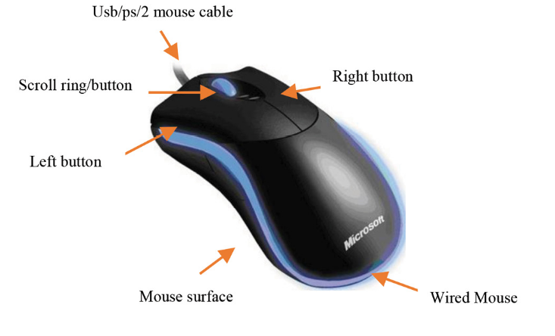
7 Mouse Operations
Point
Left click
Right click
Double click
Left drag
Right drag
Scroll button

Slide 20
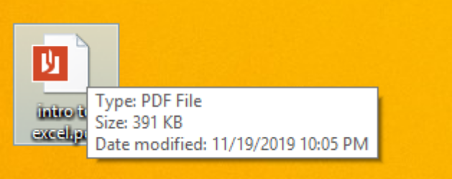
Screen Tip or Tool Tip
When you point to an object or button, you click on the tip to receive additional information about the button or object

Slide 21
Shortcut or Object Menu
Result of right clicking on an object
  Displays a set of commands specifically for that object
  You only right click to get lazy menu, then go back to your left click to select something
  “It’s right to be lazy”

Slide 22
More Menus
Menu- A list of related commands
Command- directed to perform a specific action
Submenu or cascading menu- a menu under a menu (triangle)
Ellipsis commands- more information required to execute the command (…)
commands on a computer to indicate the full file name or command is not being displayed.

Slide 23
More Menus:
Dialog box- Displays when an ellipsis command is chosen to supply more information
Dimmed Commands- commands temporarily unavailable
Standard Buttons Toolbar- Buttons for frequently used commands (print, save, open, cut, copy, paste).

Slide 24
Active Window: window currently being used
3 Ways to identify the Active window:
Dark blue title bar
It’s the window that is in front
Button on taskbar that is pushed in
Title bar:
The blue bar at the top of the window that identifies the name of the window
Can be used to move window with pointer mouse

Slide 25
Menus and Buttons:
System menu- picture icon at top left of running program
Minimize button- collapses the running program to the taskbar so that it doesn’t display on desktop (_)
Maximize button- expands window to fill entire screen (unconnected square in middle)
Restore down button- returns a window to the size it was before maximizing (connected squares in middle).
Close button- closes window (X)

Slide 26
3 ways to display information in a window that is not visible:
Maximize
Stretch to resize
Scroll area

Slide 27
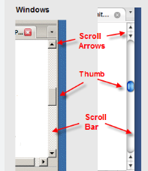
Scrolls:
Scroll arrows- used to scroll line by line/short distances
Scroll bar (elevator shaft)- used to scroll one screen at a time
Scroll box (elevator)- used to scroll long distances quickly

Slide 28
Left Drag vs. Right Drag
Left Drag:
A default operation takes place and the result may not be what you intended.
Could accidentally delete something you cannot retrieve.
Right Drag:
A menu will display and you can specify the “exact” operation you want to do.
Preferred method because it is safer.

Slide 29
Steps to Create Folders:
Choose drive/folder from folders pane where new folder is to appear
Right click in content pane
Choose New – Folder
Type the folder’s name then press [enter]

Slide 30
*Select multiple adjacent (side by side) objects:
Click on first object
Hold [shift] on keyboard
Click on last object

Slide 31
*Select multiple non-adjacent objects:
Click on first object
Hold [ctrl] on keyboard
Click on next object to be selected

Slide 32
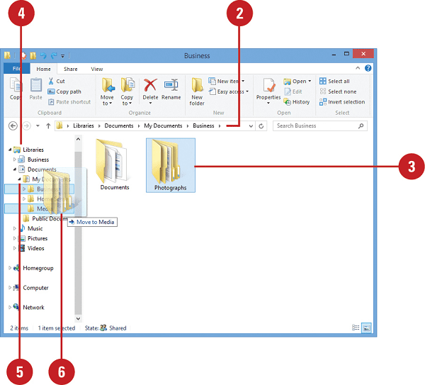
*Steps to copy a file/folder:
Select object(s) from source drive/folder
Right drag selected objects to the destination folder/drive
Choose “copy here”

Slide 33
*Steps to rename a file/folder:
Select object
Right click on object
Choose “rename”
Type new name and [enter]

Slide 34
*Steps to delete a file/folder:
Select object
Right click on object
Choose “delete”
Instead of choosing delete, can also: use delete key on keyboard or the X on tool belt

Slide 35
Deletion: hard disk vs jump drive/memory stick
Hard Disk:
Temporarily stored in recycle bin and can be restored.
Memory Stick:
Does not go to recycle bin and cannot be restored.

Slide 36
Steps to restore a deleted file:
Go to the “recycle bin”
Choose the object to undelete
Right click on object
Choose “restore”

